Slide 1
“PERCEPTION OF SELF”
Communication and Presentation Skills
Department of Computer Science
FAST NU Peshawar
Lecture by Ms. Maryam Ali Khan

Slide 2
PONDER!
Why do you think we are studying perception?
What is its role in interpersonal relationships?

Slide 3
Perception about:
  Self
  Others
How we can manage these perception to have more successful relationships

Slide 4
PARTICIPATION IN INTERPERSONAL RELATIONS
Do we ever question our performance in our relationships?

Slide 5
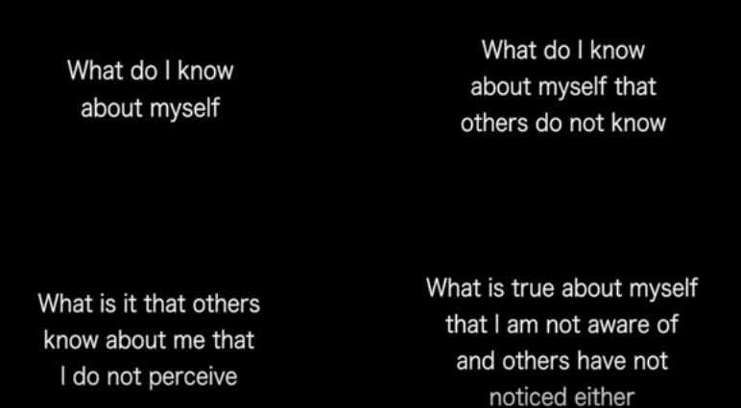
THE JOHARI WINDOW

Slide 6
TASK
What do you know about yourself?
What do you know about yourself that others do not know?
What is it that others know about you that you do not perceive? (Ask your friends)

Slide 7
IS PERCEPTION THE SAME AS REALITY?

Slide 8
You might perceive that:
  You are a certain way
  Others are a certain way

Slide 9
IS THERE ANY END TO PERCEPTION?

Slide 10
PERCEPTION IS:
Not a destination
A better way to understand yourself and others
PERCEPTION HAS NO DESTINY BUT IS A CONTINUOUS PROCESS

Slide 11
PERCEPTION OF SELF
we look at our self and form opinions
Gather this perception because of positive and negative experiences of our lives
We listen to our families and culture
A continuously discouraged child will perceive himself as someone worthless
A child who is never corrected has a perception that will impact his reationships

Slide 12
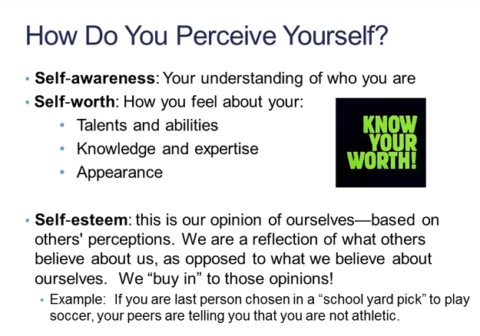

Slide 13
NEGATIVE SELF-PERCEPTION
We buy negative comments more than positive comments
Has somebody ever called you “stupid”? How did you feel? Did it shatter your confidence?
Negative self-perception leads to a sense of shame

Slide 14
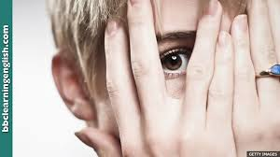
SHAME
Anorexia: eating disorder
Narcissism: desire to be noticed and validated
Recidivist: addicted to crime, self-destruction
Neurotic over-achievers

Slide 15
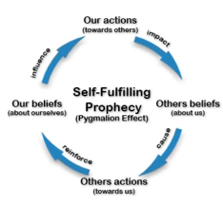
SELF- FULFILLING PROPHECY(PYGMALION EFFECT)
"predicting" or expecting something, and this "prediction" or expectation comes true simply because one believes it will happen

Slide 16
TASK:
Find out why the self-fulfilling prophecy is also called “The Pygmalion Effect”?

Slide 17
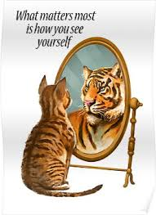

Self-fulfilling prophecy is either self-imposed or other-imposed
Self-imposed: influenced by our
own expectations
  If you believe you can become an
  athlete and try hard for it
Other-Imposed: influenced by the expectations of other people
  If parents expect their child to do well,
  they try hard for it

Slide 18
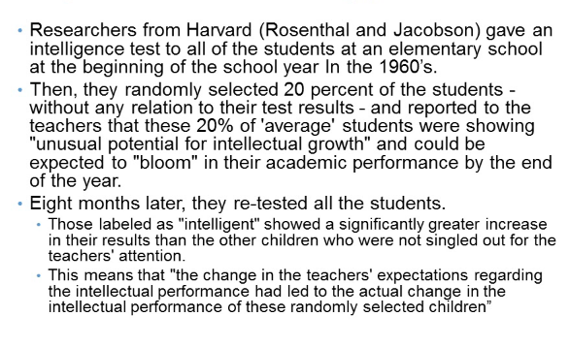

Slide 19
IDENTITY MANAGEMENT
How we handle ourselves in various settings
HOW DO WE WANT TO BE SEEN BY THE PEOPLE?
How do you act in front of your:
  Boss
  Friends
  Parents
  Colleague

Slide 20
SELF KNOWLEDGE
What do you want?
What are your needs?
What are your values?
If you don’t know the answer to the above questions, then the absence of this clear self knowledge can make you indecisive

Slide 21
SELF-PERCEPTION AND COMMUNICATION
Self perception influences:
  Our self-talk
  How we talk about ourselves with others
  How we talk about others to ourselves
  The self we present to others(social construction of self)
  Our ability to communicate with others

Slide 22
SELF-TALK
Internal conversations
People with positive self perception engage in positive-talks
I CAN DO IT
I DID A GREAT JOB
People with negative self perception engage in negative-talks
I AM NOTHING
THERE IS NO WAY I CAN DO THAT

Slide 23
How we talk about ourselves with others?
Why are some people confident?
Why do some people think they are worthless?
Positive self perception coveys a positive image about ourselves to others
Negative self perception coveys a negative image about ourselves to others
WHY DO SOME PEOPLE NAGATIVELY PORTRAY THEMSELVES?
  People with negative self-perception find it less painful to put themselves down than to hear criticism from others. Thus, to preempt the possibility that others will comment on their unworthiness, they do it first.

Slide 24
How we talk about others to ourselves?
The more accurate our self-perception, the more likely we ware to perceive others accurately.
The more positive our self-perception is, the more likely we are to see others favorably.
Positive self perception leads to thinking positively about others
Negative self perception leads to thinking critically about others a judging them negatively

Slide 25
SOCIAL CONSTRUCTION OF SELF
Social role played by us according the situation
What persona do you present when you are:
  With your friends
  With you parents
  At work
  In the class

Slide 26
WHAT IS SELF-MONITORING
We construct different social selves depending on how we self-monitor
We change our discussion according to the situation
Ever said “ I wish I had not said that. I wonder how to fix it” .
Celebrities use self-monitoring to decide which “self” to portray in public, which may be very different from the “self” they are in their private lives.

